Slide 1

Airbnb Listing Analysis
IN Beijing & Boston
Team 4, Cohort B, MSBA’20
Xiaohan Mei, Yuhong Lu, Ziyan Pei,
Peng Yuan, Mengqing Zhang, Jiayuan Zou

Slide 2

Agenda
Business Problems &
Methods
Dataset Description &
Exploratory Data Analysis
Pricing Modeling &
Text Analysis
Discussion &
Conclusion

Slide 3

01
Business Problem & Methods

Slide 4

Business Problem & Main Methods
Comparing of demand and supply between Airbnb homestays in Beijing and Boston by establishing SML including Linear, Lasso, Regression Tree, Random Forest and Boosting Model
Implementing text analysis to build insights to Airbnb homeowners (hosts) and customers (visitors) profiles

Slide 5
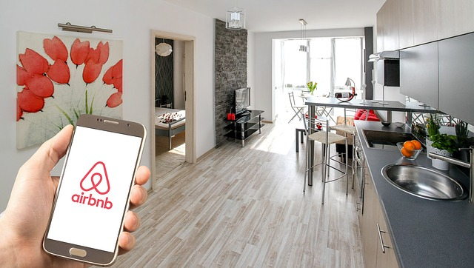
Business Problem
External differences in the Airbnb marketplaces between China & the United States
Reference opinions for homestay hosts in the pricing area
Relevant factors that affect the preferences of Airbnb consumers in China and the United States

Slide 6


Beijing
Capital of China
Northeastern of China
Snow in winter, hot in summer
Dense academic atmosphere
(busy around graduation season)
Why
Beijing & Boston
Boston
Where the group members studying & living
Northeastern of the U.S
Snow in winter, hot in summer
Lots of universities and liberal arts college
(busy around graduation season)

Slide 7
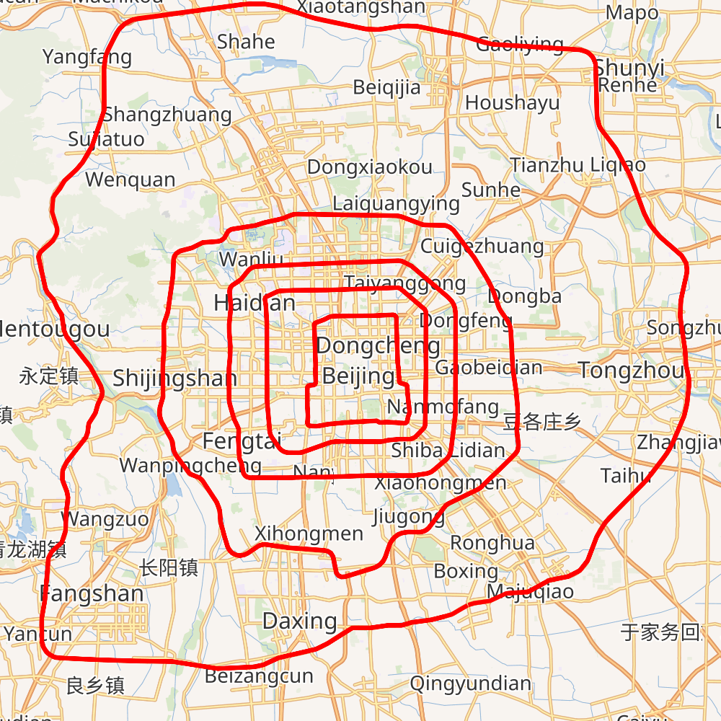
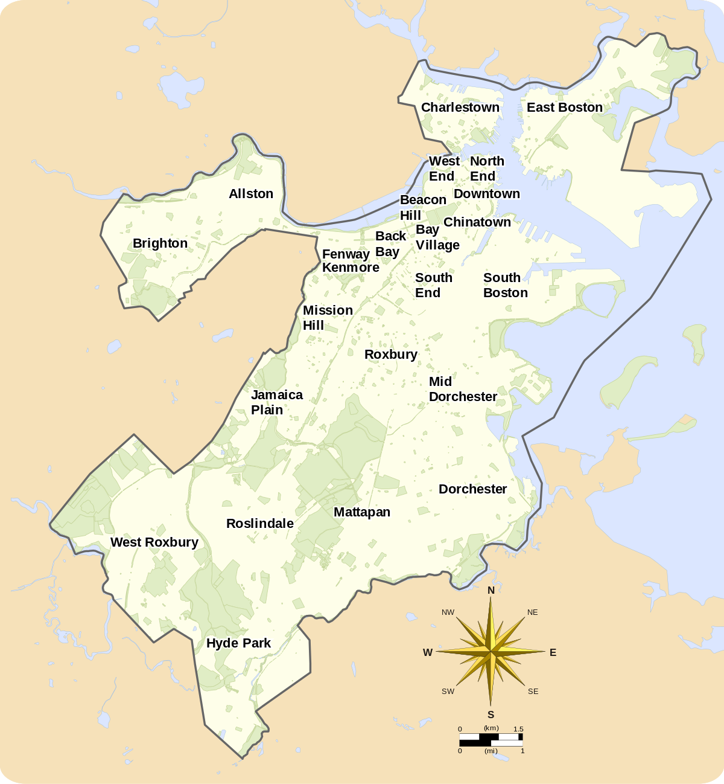
Beijing & Boton
Cityscapes Overview

Slide 8
02
Dataset Description &
Exploratory Data Analysis

Slide 9
Cleaning & Handling
Data Description
Listings
Reviews
Calender
Listings
Comments that Customers gave to the Homestays
Reports Quotes of the Listings at a Certain Date
Basic Information of the Room/House

Slide 10
Data Overview - Listings
106 variables, include description, location, the room type and review scores, etc.
Have Missing Values.
Contain Listings From Dec 2009 to Dec 2019.
3,501
Unique Boston Listings
25,921
Unique Beijing Listings
》

Slide 11
Data Overview - Reviews
148,151
# of Boston Reviews
9 variables, include listing names, reviews, date, etc.
No Missing Values
Contain Reviews From Dec 2009 to Dec 2019.
180,561
# of Beijing Reviews
》

Slide 12
Data Overview - Calendars
9 variables, report everyday pricing and availability;
No Missing Values
Contains Quotes From Dec 2018 to Dec 2020.
2,269,205
# of Boston Pricings
9,461,165
# of Beijing Pricings
》

Slide 13
Missing Values Analysis
Data Cleaning
Extract Text Information and Transfer Categorical Variables into Dummies
Remove observations if the number of N/A for one column < 5%
Use Mean based on Neighborhoods and Room Types to Replace N/A for Review Scores, Host Response Time/Rate, Security Deposit and Cleaning Fee
Limit Geographic Scope of Beijing Dataset into ‘Fifth-Ring Road’ Areas, which excludes rural areas

Slide 14
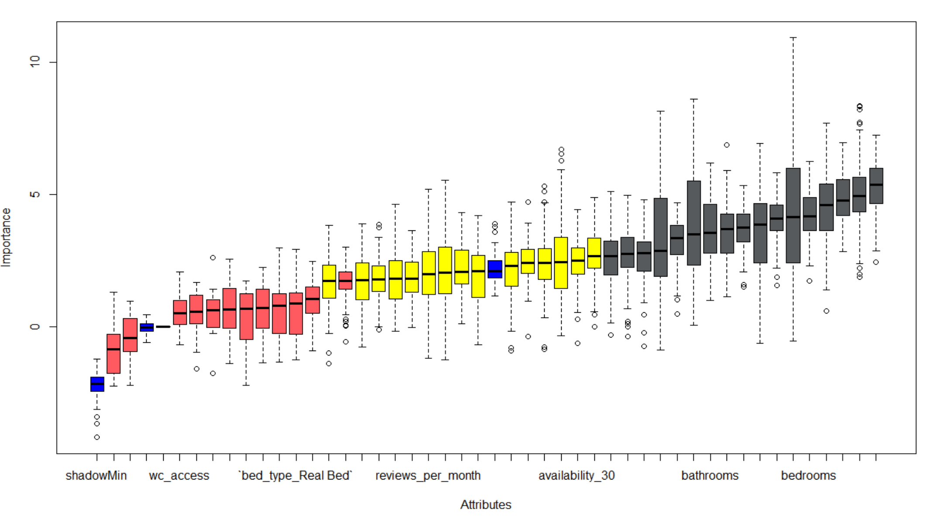
Data Handling
Boruta Feature Selection
Ex. Boruta’s Variables Importance in Boston

Slide 15

Data Handling
Variables ↓
82
Beijing ↓
42
Boston ↓
0.1
Revised
Listings Data
%
%
%
Listings Variables – 106 to 18 via importance evaluation of Boruta
Boston Listings Data – 0.1% less
Beijing Listings Data – 42% less

Slide 16
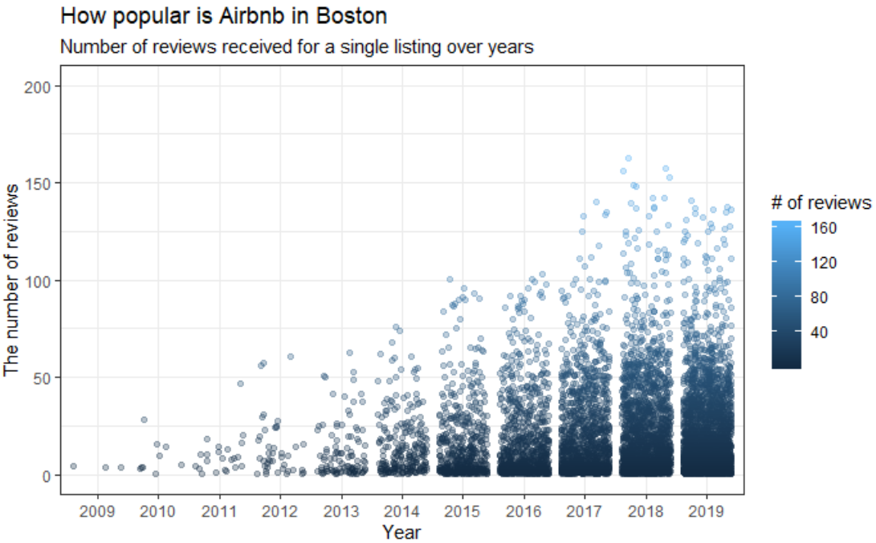
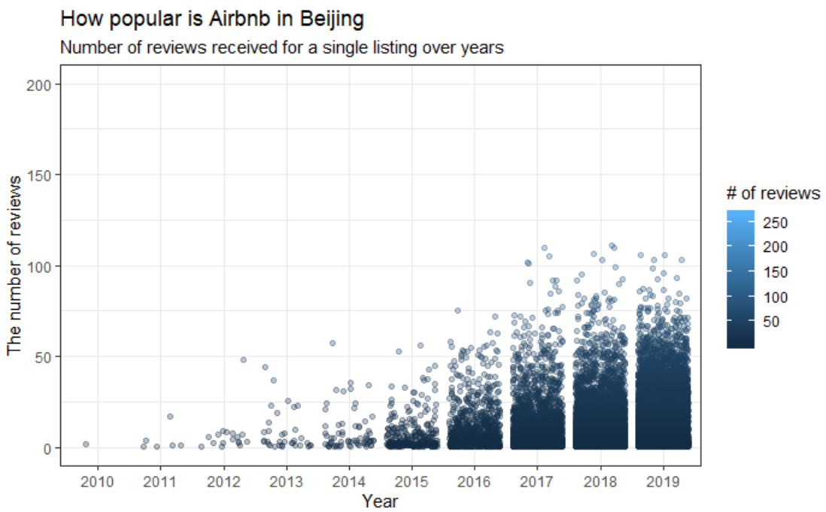
2009
Exploratory Data Analysis
Airbnb’s Popularity is Increasing
Measured by the number of comments made by customers.
2019

Slide 17

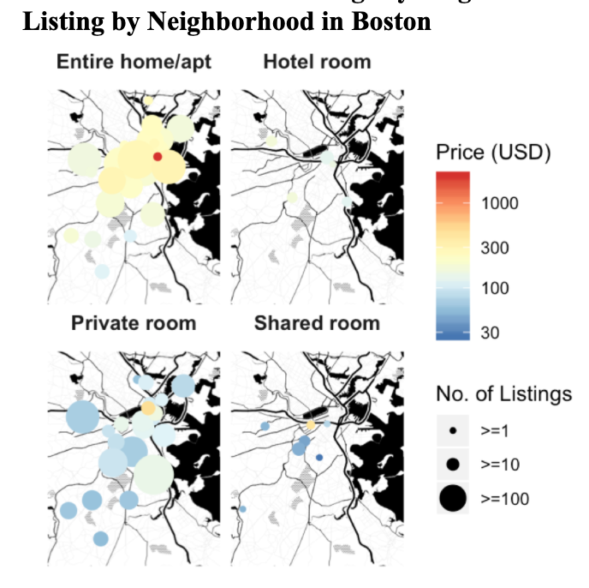
Exploratory Data Analysis
Closer to Downtown,
the Price Goes Higher
Boston

Slide 18
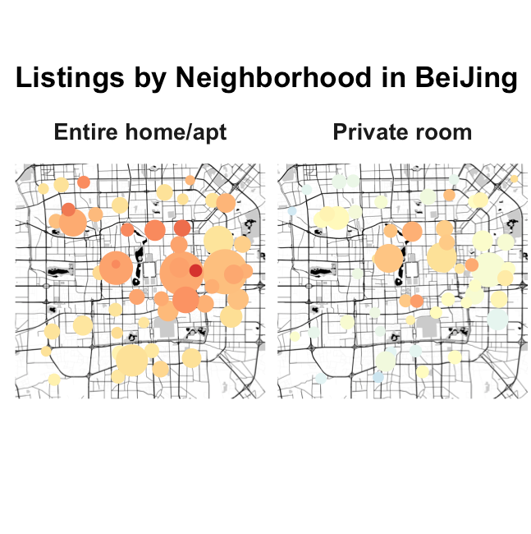

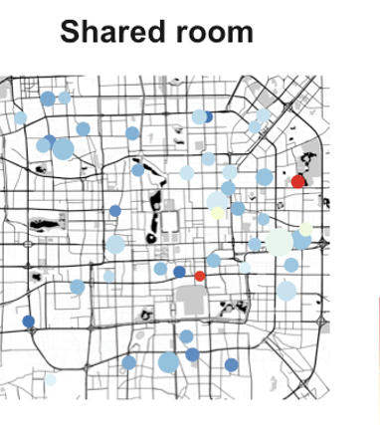
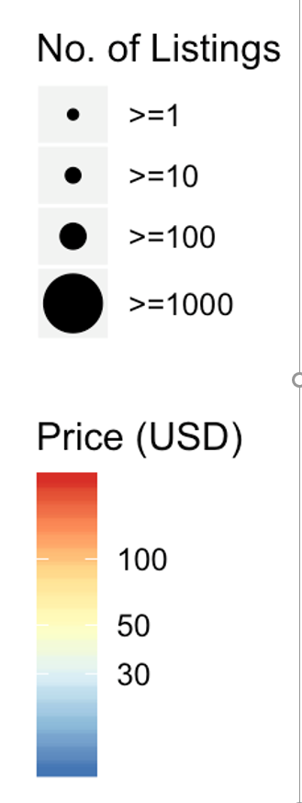
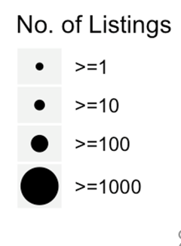
Exploratory Data Analysis
Price Distributed Evenly Around Ring-Roads
Beijing

Slide 19
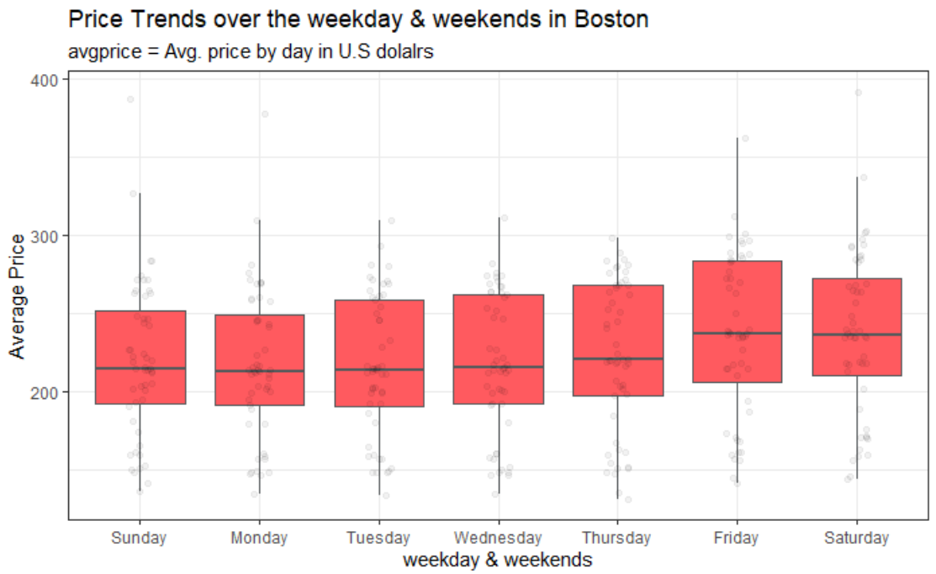
Exploratory Data Analysis
Price is Higher on Friday to
Saturday
Boston

Slide 20
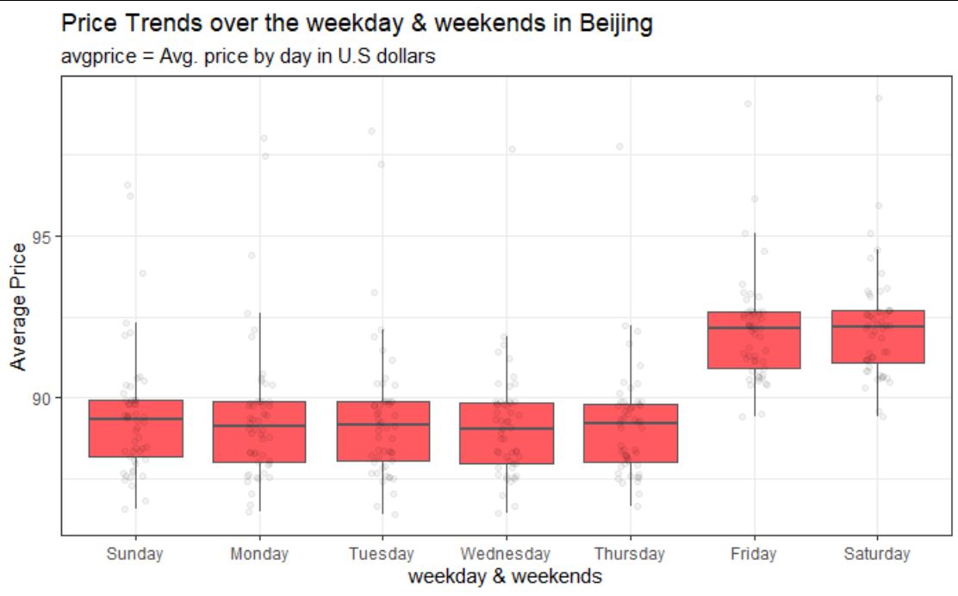
Exploratory Data Analysis
Price is Higher on Friday to
Saturday
Beijing

Slide 21
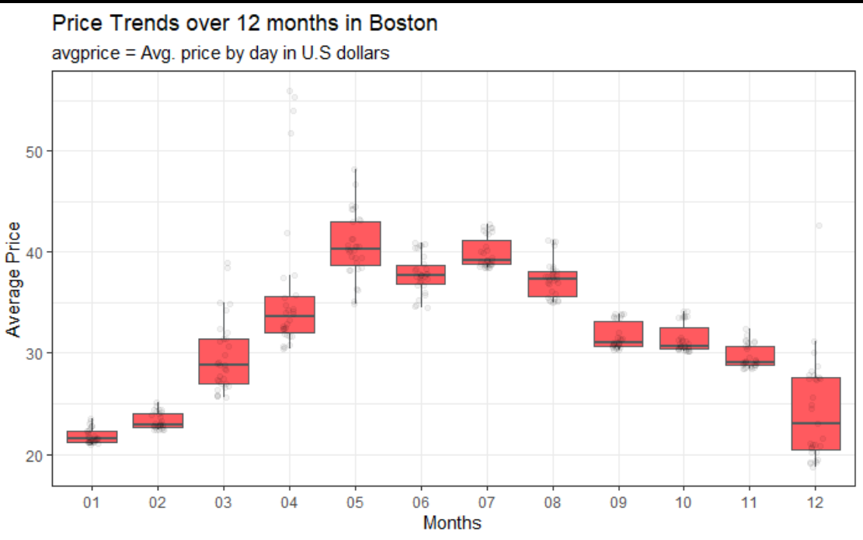
Exploratory Data Analysis
Higher Prices
in Summer
Boston

Slide 22
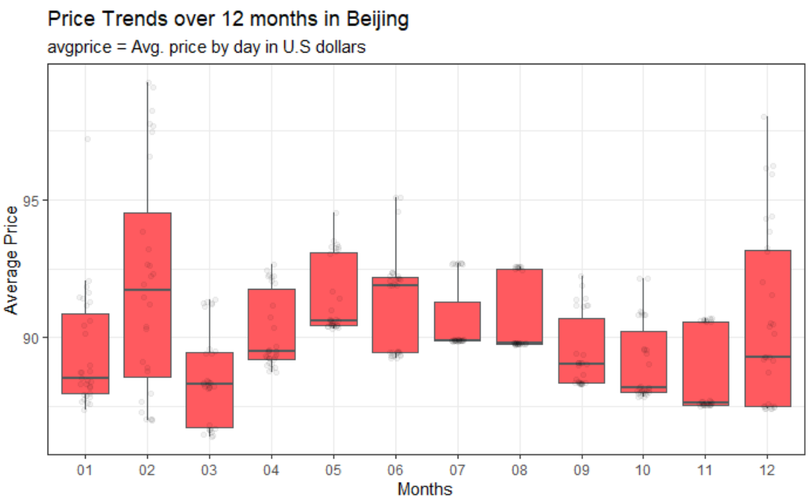
Exploratory Data Analysis
Higher Prices
in Summer
Beijing

Slide 23
03
Price Modeling

Slide 24
Linear Regression
 | Estimate | Std. Error | t value | Pr(>|t|)
(Intercept) | 56.217272 | 10.031809 | 5.604 | 2.32E-08 | ***
host_listings_count | 0.041642 | 0.005575 | 7.47 | 1.09E-13 | ***
accommodates | 26.249442 | 1.406483 | 18.663 | <2.00E-16 | ***
bathrooms | 4.493217 | 3.25414 | 1.381 | 0.167469
bedrooms | 9.745793 | 2.741845 | 3.554 | 0.000386 | ***
beds | -10.620643 | 2.097182 | -5.064 | 4.39E-07 | ***
guests_included | 4.408934 | 1.277413 | 3.451 | 5.67E-04 | ***
maximum_nights | 0.005659 | 0.002849 | 1.986 | 0.047086 | *
number_of_reviews | -0.003303 | 0.032706 | -0.101 | 0.919567
number_of_reviews_ltm | -0.269537 | 0.100485 | -2.682 | 0.007357 | **
wifi_available | -4.305054 | 9.506387 | -0.453 | 0.650688
host_response_time_nodata | 3.319442 | 4.706871 | 0.705 | 0.480729
cancellation_policy_strict | 47.400033 | 9.370591 | 5.058 | 4.53E-07 | ***
neighbourhood_cleansed_Bay Village | 35.368097 | 11.023923 | 3.21E+00 | 0.001352 | **
neighbourhood_cleansed_Beacon Hill | 44.135579 | 7.383186 | 5.978 | 2.57E-09 | ***
neighbourhood_cleansed_Mattapan | -71.263155 | 15.273444 | -4.666 | 3.23E-06 | ***
neighbourhood_cleansed_South Boston | 39.347824 | 6.493001 | 6.06E+00 | 1.56E-09 | ***
neighbourhood_cleansed_South Boston Waterfront | 58.485246 | 10.281097 | 5.69E+00 | 1.42E-08 | ***
neighbourhood_cleansed_West End | 62.043812 | 9.254131 | 6.704 | 2.47E-11 | ***
Boston’s Listing
R-square - 44.18%
Train MSE - 5,012
Test MSE - 5,622

Slide 25
Linear Regression
 | Estimate | Std. Error | t value | Pr(>|t|)
(Intercept) | 9.63E+01 | 1.07E+01 | 9.014 | <2.00E-16 | ***
host_listings_count | 1.12E+00 | 9.46E-02 | 11.806 | <2.00E-16 | ***
Accommodates | 3.63E+01 | 2.04E+00 | 17.81 | <2.00E-16 | ***
Bathrooms | 9.23E+01 | 5.37E+00 | 17.178 | <2.00E-16 | ***
Bedrooms | 9.41E+01 | 4.96E+00 | 18.986 | <2.00E-16 | ***
Beds | -2.20E+01 | 2.40E+00 | -9.165 | <2.00E-16 | ***
minimum_nights | 3.19E-02 | 1.07E-01 | 0.298 | 0.766
maximum_nights | 3.15E-03 | 2.24E-03 | 1.41 | 0.159
guests_included | -1.92E+00 | 2.10E+00 | -0.912 | 0.362
availability_30 | 1.95E+00 | 4.61E-01 | 4.227 | 2.39E-05 | ***
availability_90 | -7.84E-02 | 1.81E-01 | -0.433 | 0.665
availability_365 | 1.01E-01 | 2.09E-02 | 4.841 | 1.31E-06 | ***
number_of_reviews | -2.08E-01 | 1.74E-01 | -1.199 | 0.231
number_of_reviews_ltm | -1.68E+00 | 3.17E-01 | -5.309 | 1.12E-07 | ***
TV_available | 9.98E+01 | 6.05E+00 | 16.487 | <2.00E-16 | ***
wc_access | -1.72E+01 | 1.25E+01 | -1.377 | 0.168
room_type_Shared room | -2.59E+02 | 1.15E+01 | -22.58 | <2.00E-16 | ***
host_response_time_within a day | -1.73E+01 | 1.20E+01 | -1.441 | 0.15
room_type_Private room | -6.64E+01 | 5.87E+00 | -11.311 | <2.00E-16 | ***
Beijing’s Listing
R-square - 38.42%
Train MSE - 1,244
Test MSE - 1,221

Slide 26
Multiple Trees - Boston
7.1 %
6.2 %
53.9 %
Decision Tree
Random Forest
Gradient Boosting
Train MSE - 44,362
Test MSE - 153,067
Train MSE 21,307
Test MSE 154,589
Train MSE 4,051
Test MSE 4,188

Slide 27
Multiple Trees - Beijing
1.1 %
3.2 %
49.0 %
Decision Tree
Random Forest
Gradient Boosting
Train MSE 645,739
Test MSE 1023,998
Train MSE 225,742
Test MSE 1002,295
Train MSE 19,865
Test MSE 19,018

Slide 28
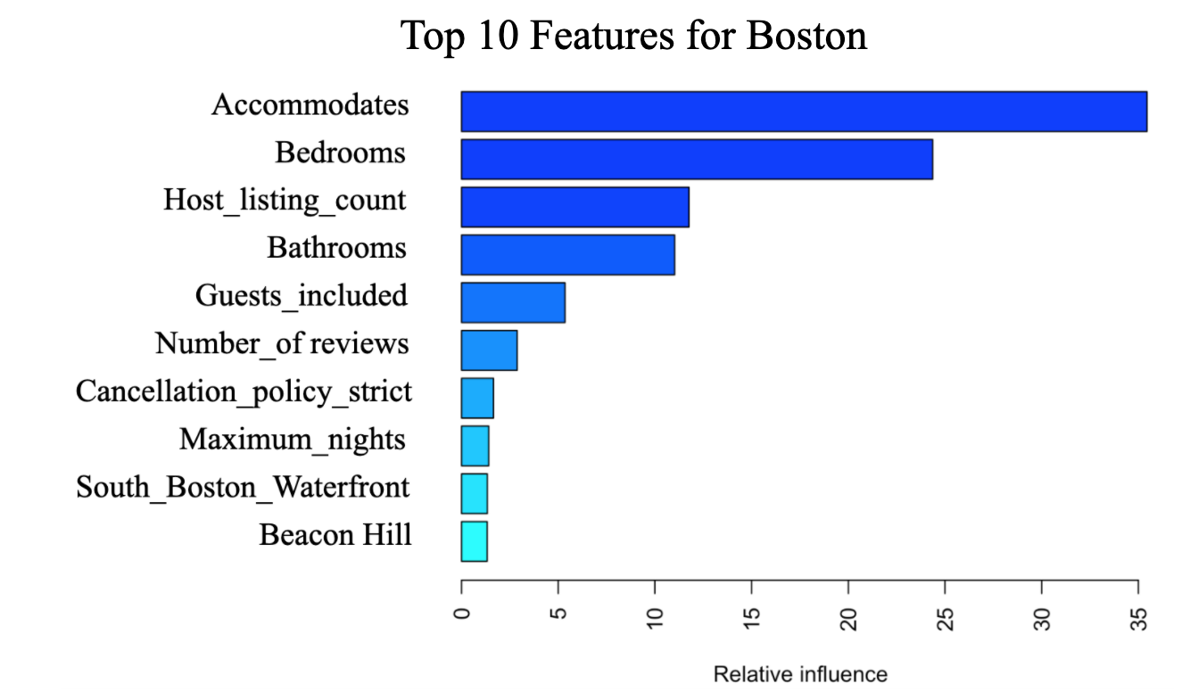
eXtreme Gradient Boosting
Boston’s Listing
Controlling 1000 rounds
0.05 eta learning rate
Maximum Tree Depth of 6
50% Features Per Tree
90% Samples Per Tree
With Handling of Outliers
R-square - 64.80%
Train MSE - 572
Test MSE - 3,367

Slide 29
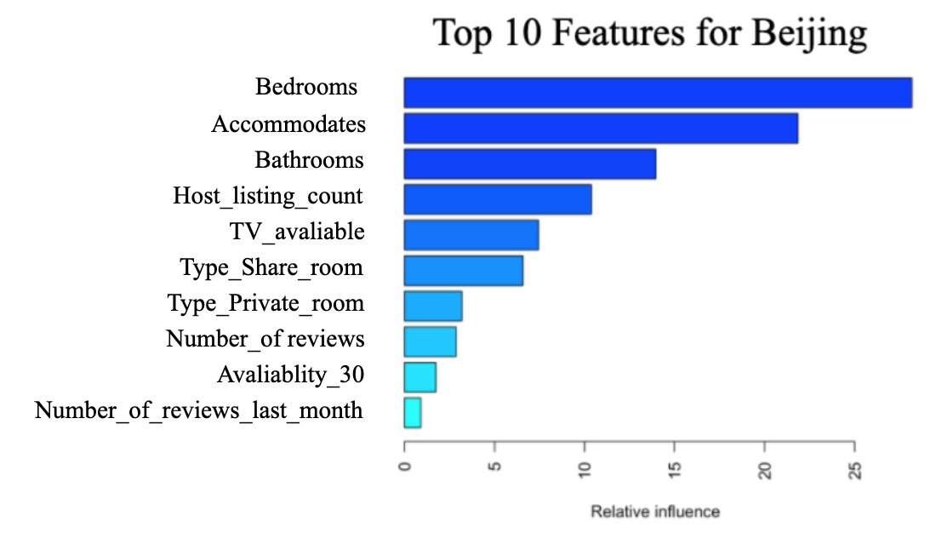
eXtreme Gradient Boosting
Beijing’s Listing
Controlling 1000 rounds
0.05 eta learning rate
Maximum Tree Depth of 6
70% Features Per Tree
50% Samples Per Tree
With Handling of Outliers
R-square - 55.70%
Train MSE - 647
Test MSE - 6,518

Slide 30
04
Text Analysis

Slide 31
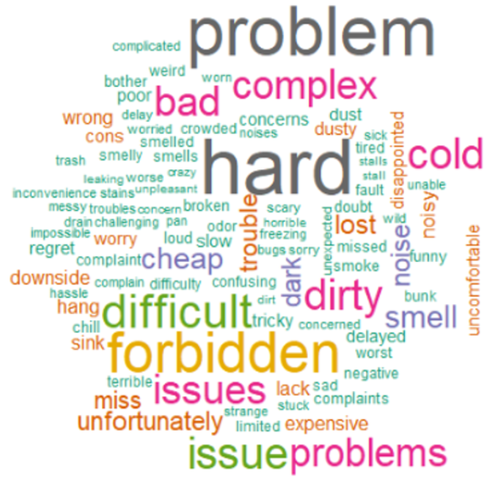
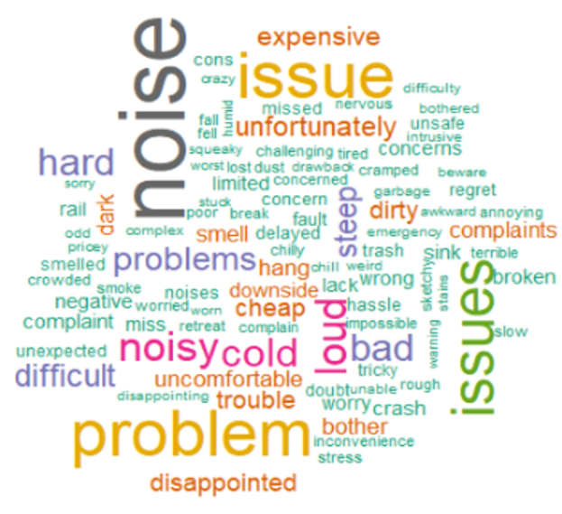
NLP Analysis
Top Negative Words
Beijing English Reviews Boston English Reviews

Slide 32


NLP Analysis
Top Positive Words
Beijing English Reviews Boston English Reviews

Slide 33
05
Discussion & Conclusion

Slide 34
Model Selection
Discussion & Evaluation
Boston Model | Linear Regression | Decision Tree | Random Forest | Gradient Boosting | XGBoost
MSE | Train 5,012 Test 5,622 | Train 44,362 Test 153,067 | Train 21,307 Test 154,589 | Train 4,051 Test 4,188 | Train 572 Test 3,367
R-Square | 44.18% | 7.11% | 6.19% | 53.91% | 64.80%
Xgboost has the lowest Train & Test Errors
Which explains around 65% variability of the price changes

Slide 35
Model Selection
Discussion & Evaluation
Beijing Model | Linear Regression | Decision Tree | Random Forest | Gradient Boosting | XGBoost
MSE | Train 1,244 Test 1,221 | Train 645,739 Test 1023,998 | Train 225,742 Test 1002,295 | Train 19,865 Test 19,018 | Train 647 Test 6,518
R-Square | 39.46% | 1.04% | 3.14% | 49% | 55.7%
Xgboost has the lowest Train & Test Errors
Which explains around 56% variability of the price changes

Slide 36
Discussion & Evaluation
Model Selection
Linear Regression
Lasso Regression
Decision Tree
1st Highest Interpretability
2nd Higher Interpretability
3rd Higher Interpretability
Model Complexity →
← Model Interpretability
Random Forest
Gradient Boosting
XGBoost
3rd Higher Predictability
2nd Higher Predictability
1st Highest Predictability

Slide 37
Suggestions…
To Airbnb Hosts in Boston
Quality! Quality! Quality!
Response Inquiries Immediately
Pricing By Your Neighbor
Customers tend to write positive feedback for your homestays if you can make them cozy, clean and soundproof
Check the email and reply to the inquiries as frequently as you can! It is different from Beijing’s Airbnb customers – who don’t care about response time too much.
Locations in Boston have a strong relationship with the hosting price. If your houses are in the Mattapan, you may encounter natural competitive disadvantages on price compared with other locations.

Slide 38
Suggestions…
To Airbnb Hosts in Beijing
Be Friendly, Responsive, Helpful
Setting Proper Availabe Periods
Be Close to Subways
You are more easily recommended by customers if you are warm hearted enough, which can even outweigh some shortcomings of the houses.
Consider whether to attract more long-term tenants or short-term tourists because that really influences your pricing strategy.
You are easily recommended if they have easy access to public transportation. You don’t have to price your listings lower if you are not in the center of Beijing.

Slide 39
Goals in the Future
Criticisms & Future Directions
No Polarity Scores For Chinese Comments
We only Built Polarity Scores for English Comments of Both City’s Reviews Data. Hopefully We Can Gain Access to appropriate Chinese Sentiment Database in the Future
No Image Data
Not Address the COVID-19
Beautiful Pictures May Influence the Demand of the Houses, and thereby Influence the Pricing
Black Swan – There is No Supply and Demand in Beijing Airbnb Marketplaces. Hopefully We Can Simulate It in the Future
Notes:
【使用提示】计划四项的逻辑页，可以为四项文本排版展示

Slide 40
References
Berhane, Fisseha. “Extreme Gradient Boosting with R and Python.”Datascience-Enthusiast, datascience-enthusiast.com/R/ML_python_R_part2.html.
Lewis, Laura. “Predicting Airbnb Prices with Machine Learning and Deep Learning.” Medium, Towards Data Science, 22 May 2019, towardsdatascience.com/predicting-airbnb-prices-with-machine-learning-and-deep-learning-f46d44afb8a6.

Slide 41

Thank You!
Team 4, Cohort B, MSBA’20
Xiaohan Mei, Yuhong Lu, Ziyan Pei,
Peng Yuan, Mengqing Zhang, Jiayuan Zou

Slide 42

NLP Analysis
Top Words of Chinese Comments
Hosts (房东)
Rooms (房间)
Clean (干净)
Subway (地铁)
Female Hosts (姐姐)
Beijing Reviews In Chinese

